Slide 1
5G NETWORK DEPLOYMENTS DATA ANALYSIS
Graph Analysis and Algorithm
R Arivanandam – CB.SC.I5DAS21114
Mathangi Sriram – CB.SC.I5DAS21039

Slide 2
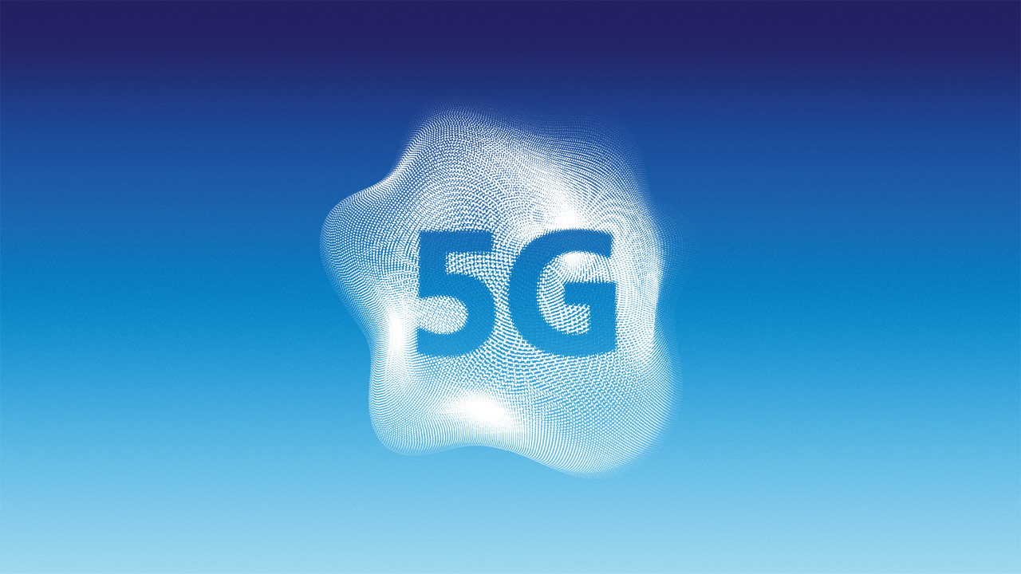
5G Data
5G is the fifth generation of wireless cellular technology, offering higher upload and download speeds, more consistent connections, and improved capacity than previous networks. 5G is much faster and more reliable than the currently popular 4G networks and has the potential to transform the way we use the internet to access applications, social networks, and information. For example, technologies like self-driving cars, advanced gaming applications, and live streaming media that require very reliable, high-speed data connections are set to benefit greatly from 5G connectivity.

Slide 3

Benefits of 5G
5G networks enable new business capabilities in autonomous mobility, smart factories, and virtual/augmented reality. The low latency supports self-driving cars, while wireless IoT connectivity and edge computing improve manufacturing efficiency and predictive maintenance. 5G's high bandwidth also makes VR/AR more accessible for applications like remote guidance and collaboration.
Beyond businesses, 5G is expected to power smart city innovations, optimizing urban infrastructure and services through real-time data. In healthcare, 5G enables remote procedures and personalized monitoring. Environmentally, 5G's efficiency supports reduced emissions through technologies like electric vehicles and remote work.
This Photo by Unknown author is licensed under CC BY.

Slide 4

5G in India
The two largest operators in India, Reliance Jio Infocomm and Bharti Airtel, are rapidly expanding 5G networks after they initially launched this technology in October 2022, while financially-troubled Vodafone Idea is still working to be in a position to launch 5G in the coming months.
Initial 5G use cases in India include high-speed internet, low latency applications, and emerging technologies, though challenges remain around device affordability and infrastructure investments. The government is promoting 5G adoption through initiatives like creating a 5G testbed and supporting indigenous technology development. Overall, the 5G rollout in India is still in its early stages, but momentum is building for its widespread deployment across the country.

Slide 5

Deployment
The deployment of network towers refers to the process of setting up new cell tower infrastructure to expand and enhance a telecom operator's network coverage and capacity. This typically involves carefully selecting the tower site location, constructing the physical tower structure, installing the necessary active and passive network equipment, integrating the new tower with the existing network, and conducting thorough testing and optimization. The goal of tower deployment is to commission the new infrastructure and make it operational, enabling the telecom network to serve more subscribers with improved connectivity and performance. This deployment process requires meticulous planning and execution to ensure the seamless integration of the new tower assets into the overall network.

Slide 6
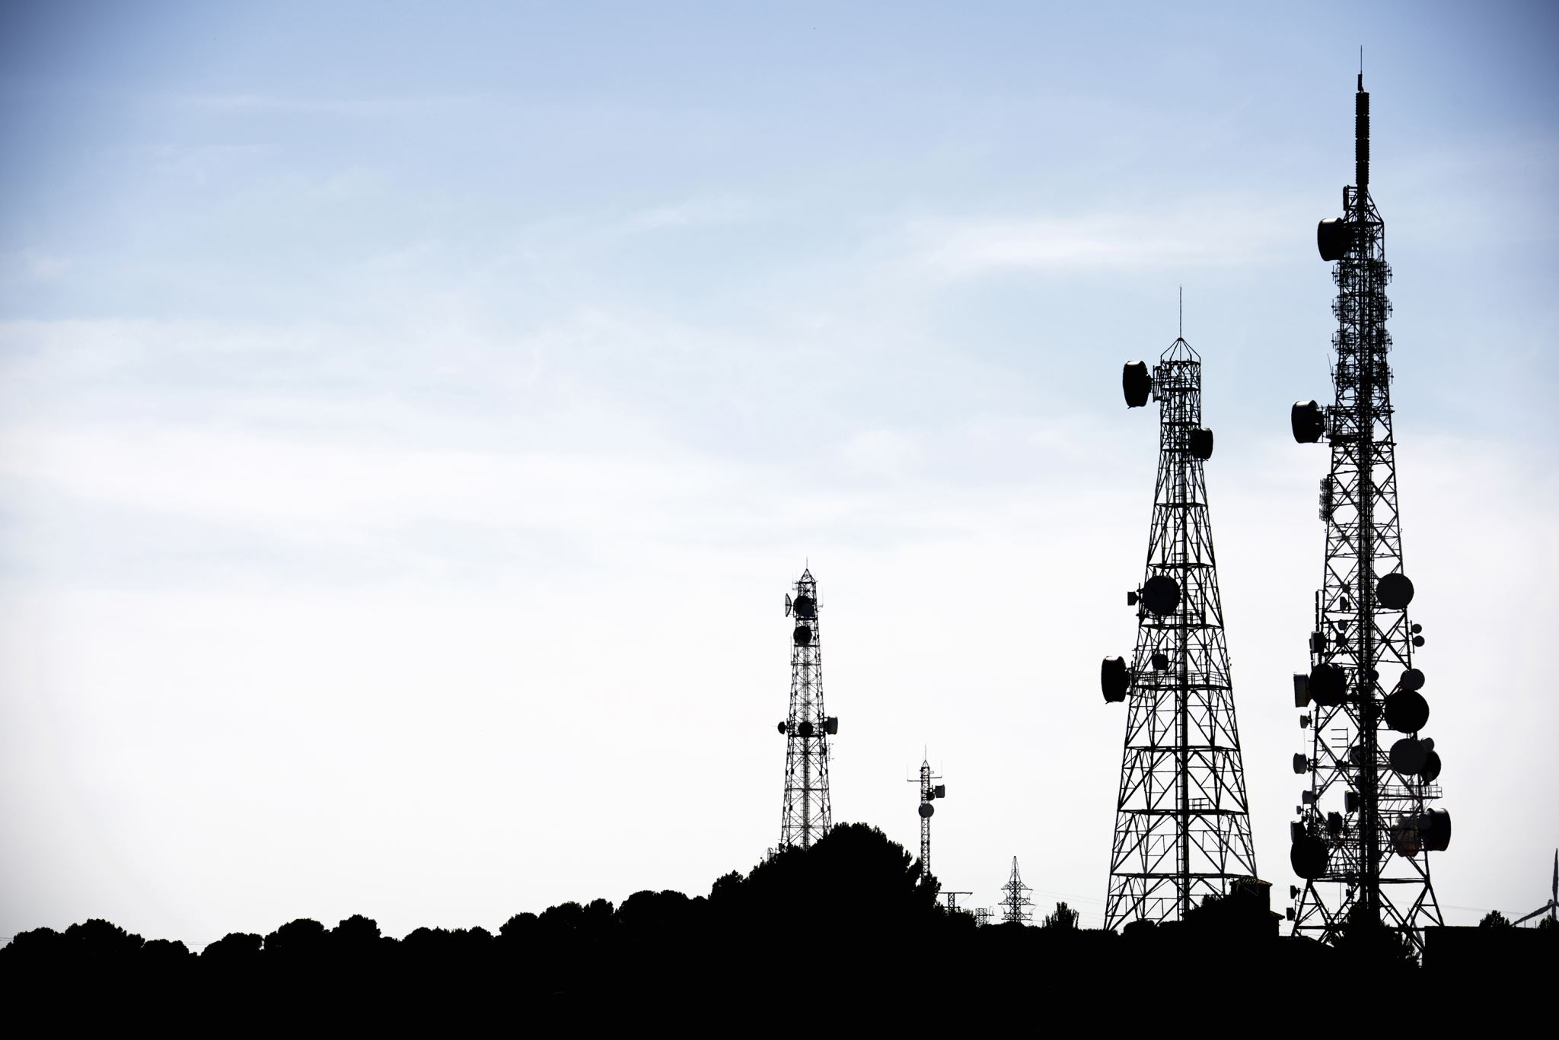
Tower-sharing
Telecom operators often share tower infrastructure to reduce costs and optimize network coverage. Through tower sharing agreements, they can co-locate their active network equipment on the same physical tower structure, allowing them to jointly use the passive infrastructure like the tower, power supply, and backhaul connectivity. This practice of passive infrastructure sharing is common, especially in rural or remote areas where building individual tower sites may not be feasible. Regulatory requirements in some countries also mandate or encourage such tower sharing arrangements between competing telecom networks to ensure efficient utilization of tower assets and minimize the environmental impact of multiple tower sites.

Slide 7
Objective
The objective of this analysis is to examine the geographical distribution of 5G deployments by major telecom operators in India, specifically Airtel and Reliance Jio. The focus is on predicting the operator based on geographical coordinates using machine learning models like K-Nearest Neighbors and Graph Convolutional Networks. The aim is to provide insights into optimal operator recommendations for users based on their location and to identify deployment patterns for strategic decision-making.

Slide 8
Centrality Measures
Centrality measures are metrics used to quantify the relative importance or influence of nodes within a network.
These measures provide insights into the structural significance of nodes based on various criteria.
They are of many types, here we are discussing about
Degree centrality
Closeness centrality
Betweenness centrality
Eigen-vector centrality

Slide 9
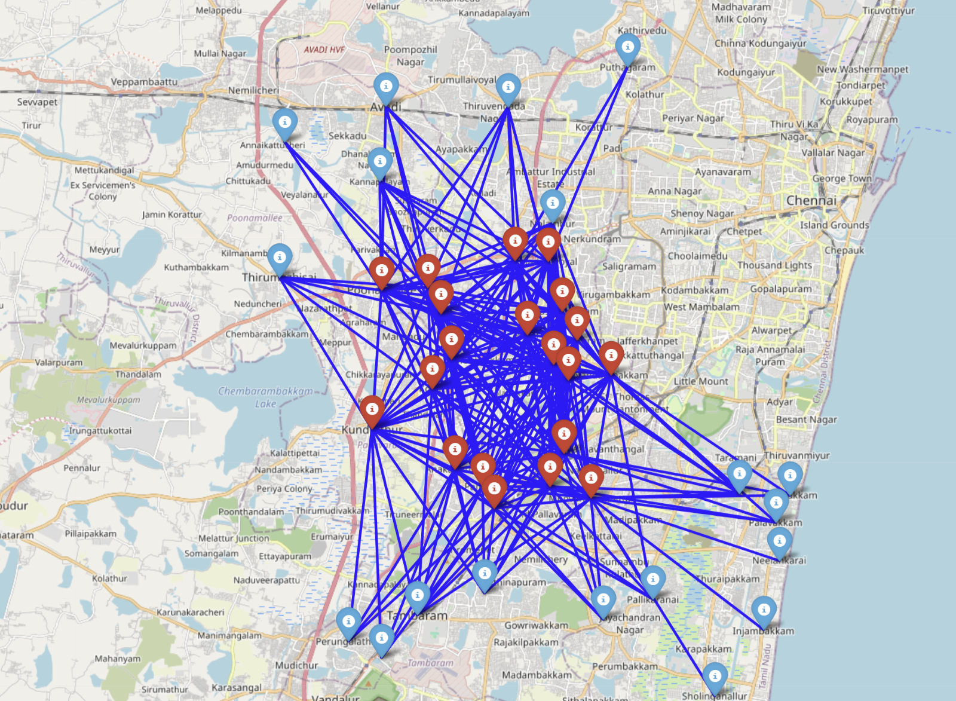
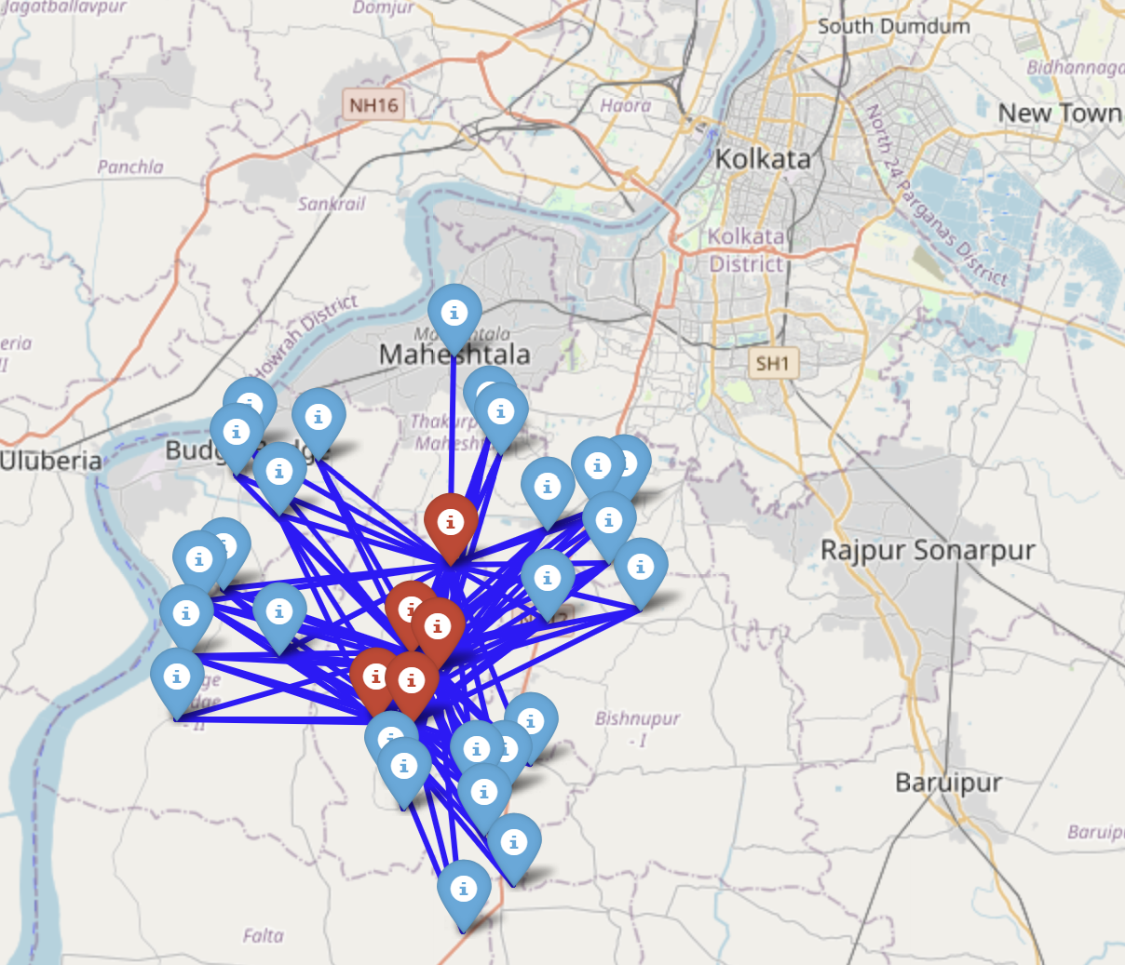
Degree Centrality
In our data we have detected the top 25 influential nodes with respect to their degree centrality. These node’s neighbouring nodes and edges are plotted on top of a map to give us an idea about the 5g network connectivity.​
The top 25 nodes are present in the outskirts of Chennai and Kolkata.

Slide 10
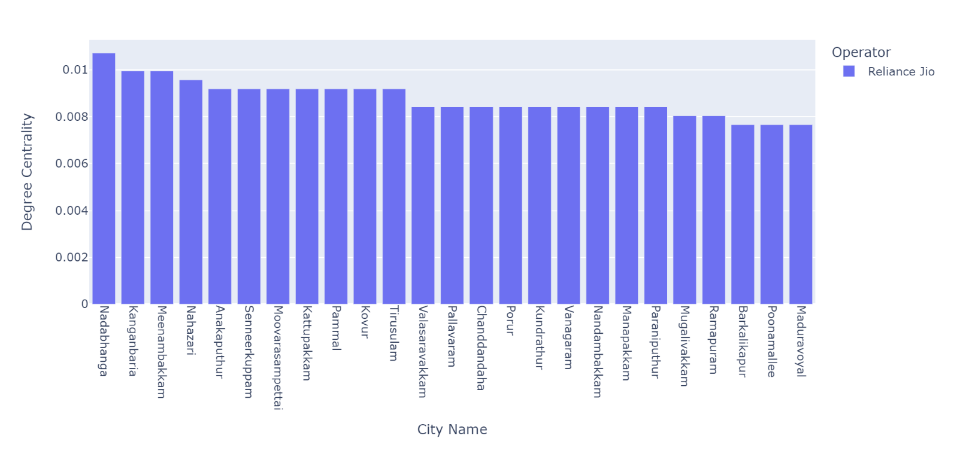
Top 25 Cities by Degree Centrality

Slide 11
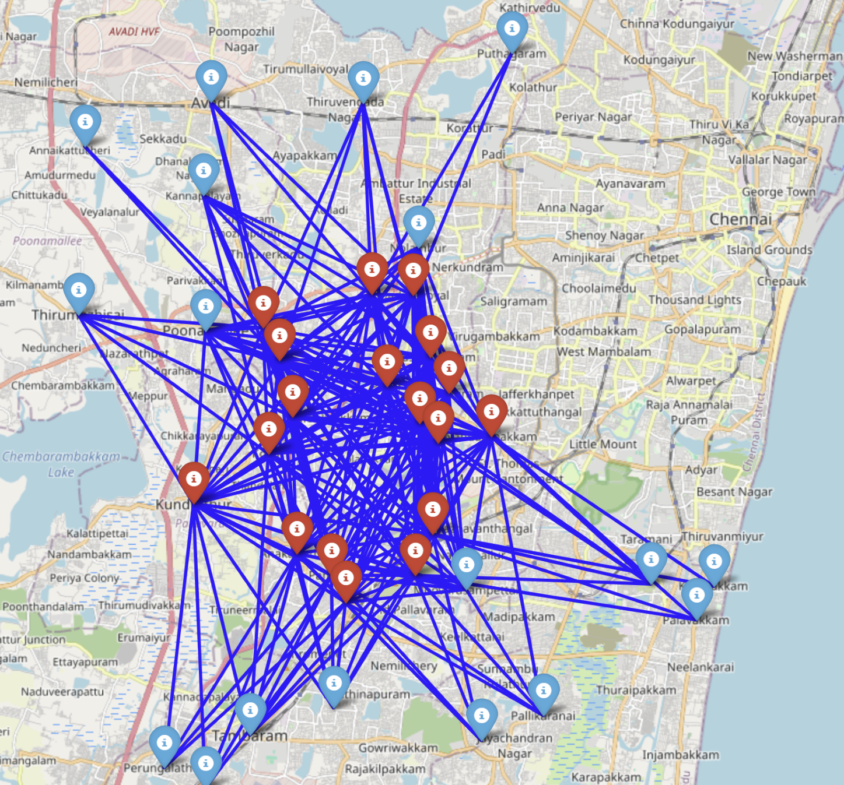
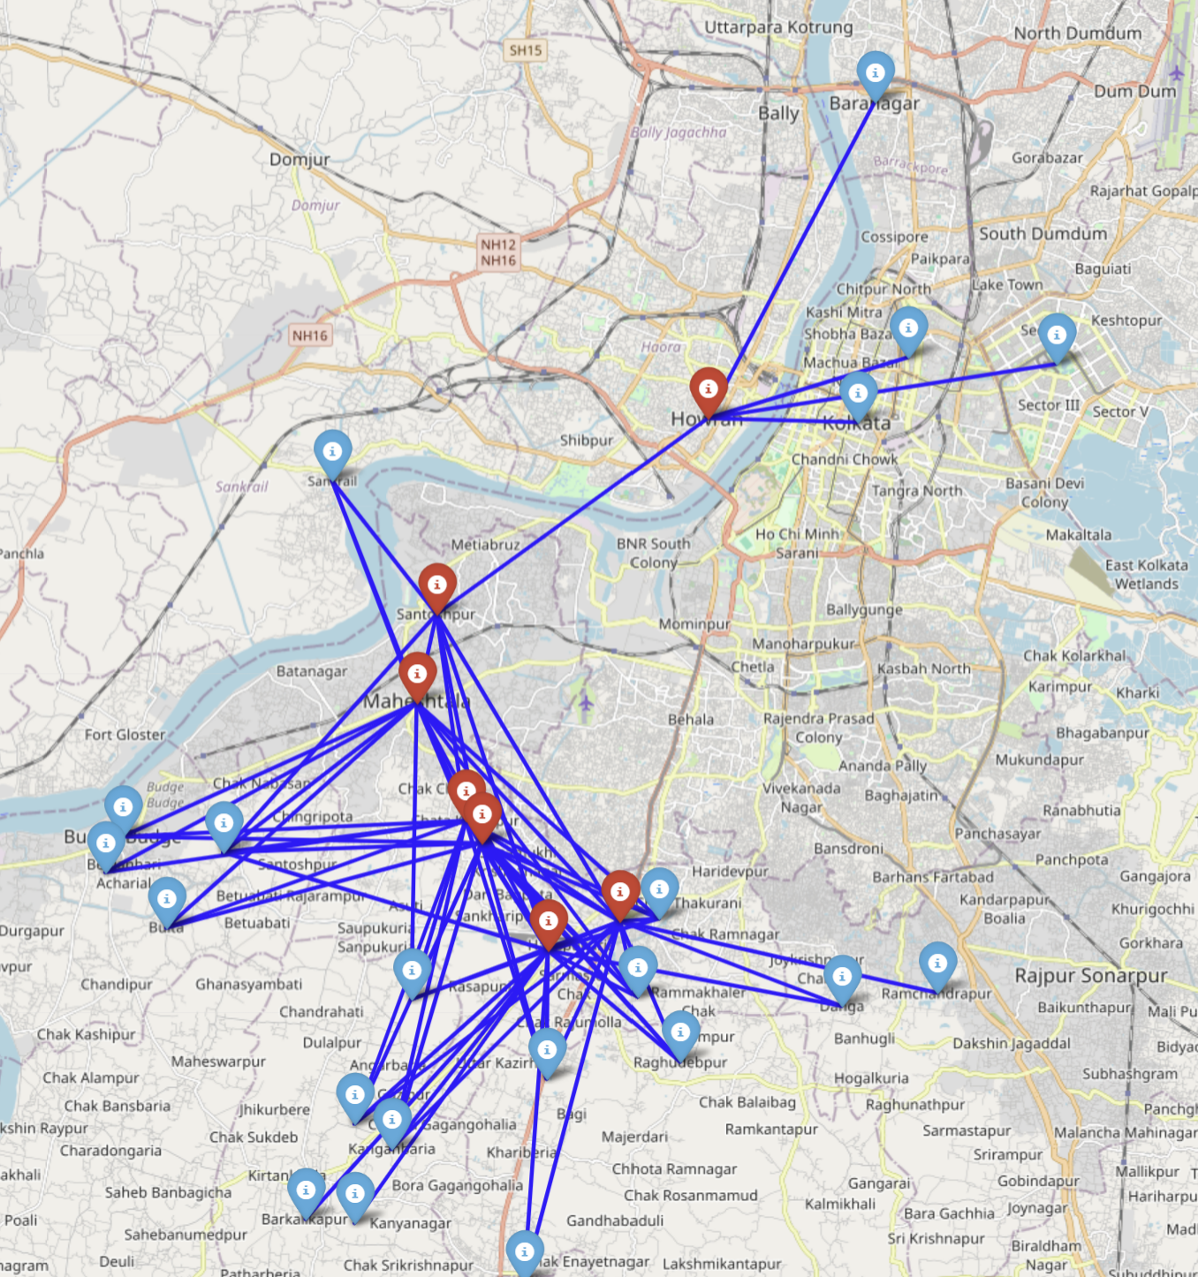
Closeness Centrality
In our dataset, we have identified the top 25 influential nodes based on their closeness centrality. These nodes serve as important points within the network, as they are strategically positioned to efficiently transfer information or resources to other nodes.
A noticeable trend in closeness centrality mirrors that observed in degree centrality within the outskirts of Kolkata and Chennai.

Slide 12
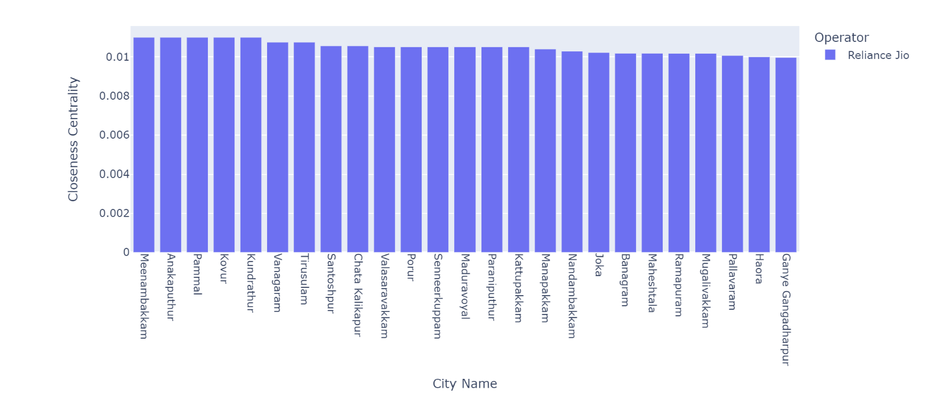
Top 25 Cities by Closeness Centrality

Slide 13
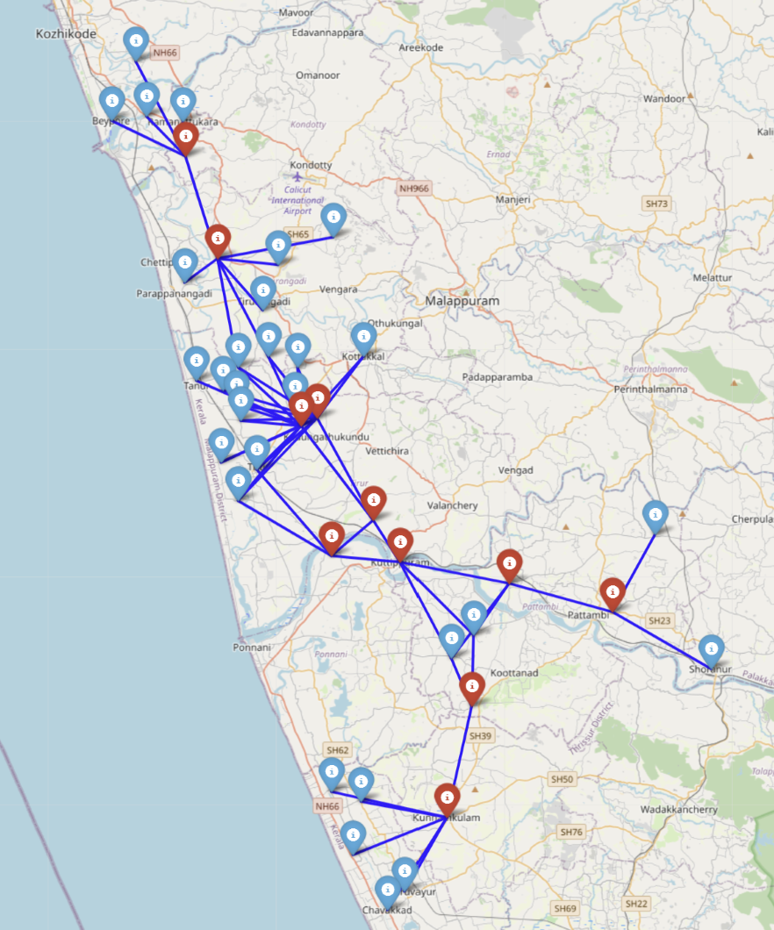
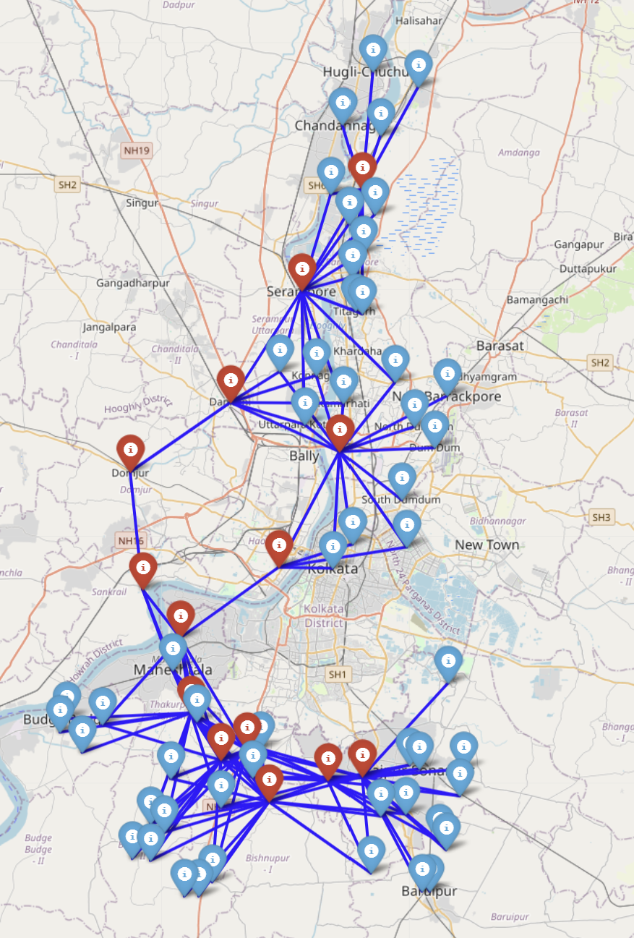
Betweenness Centrality
Our dataset has identified the 25 most important nodes in the 5G network based on their high betweenness centrality. These nodes play a crucial role in controlling the flow of information within the network, as they act as key bridges connecting various locations.
Both in Kolkata and Kerala there is a good linkage connecting various towers

Slide 14
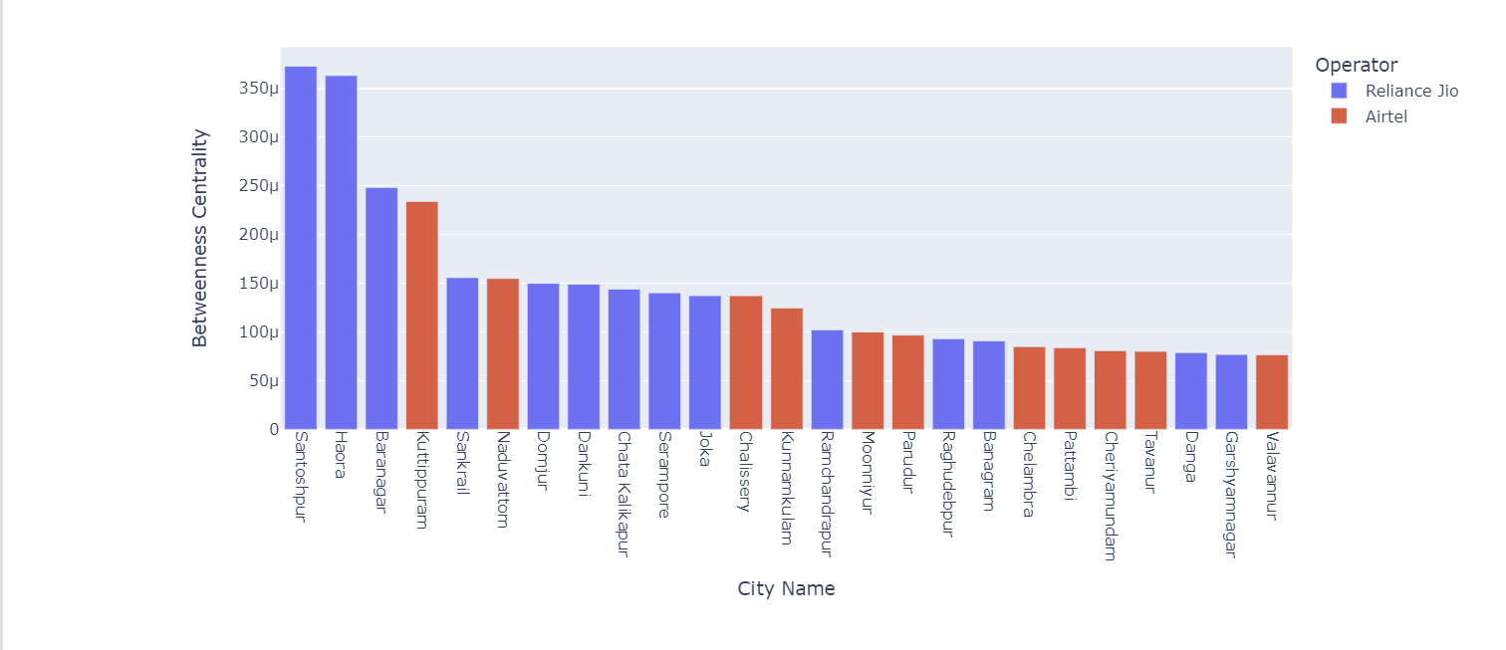
Top 25 Cities by Betweenness Centralities

Slide 15
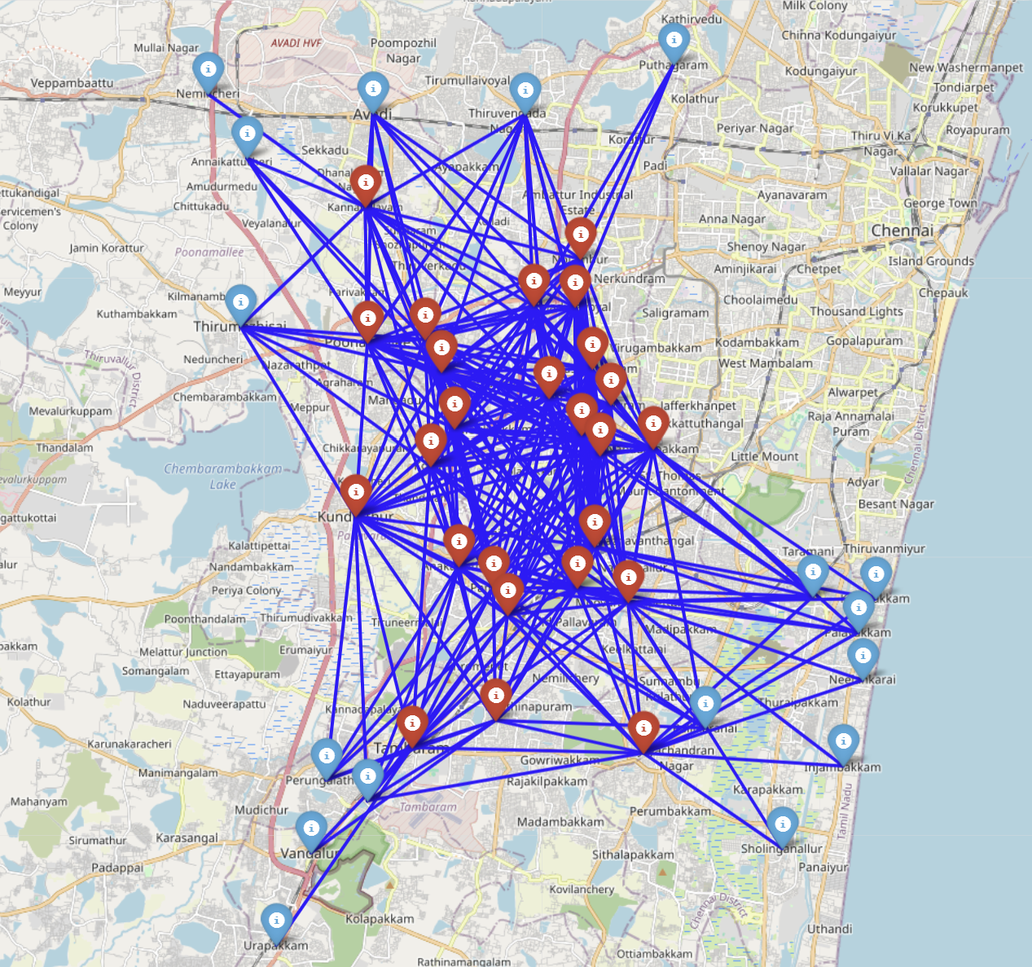
Eigen-vector Centrality
We have identified the 25 most influential nodes in the 5G network based on their high eigenvector centrality. These nodes play a crucial role in determining the flow of information and communication within the network. Visualizing the location of these key nodes and their connections on a map gives us important insights into the central players and connectivity structures that are shaping the dynamics of the 5G network.
In Chennai it is not only well-connected themselves but are also connected to other nodes that are themselves important in the network.

Slide 16
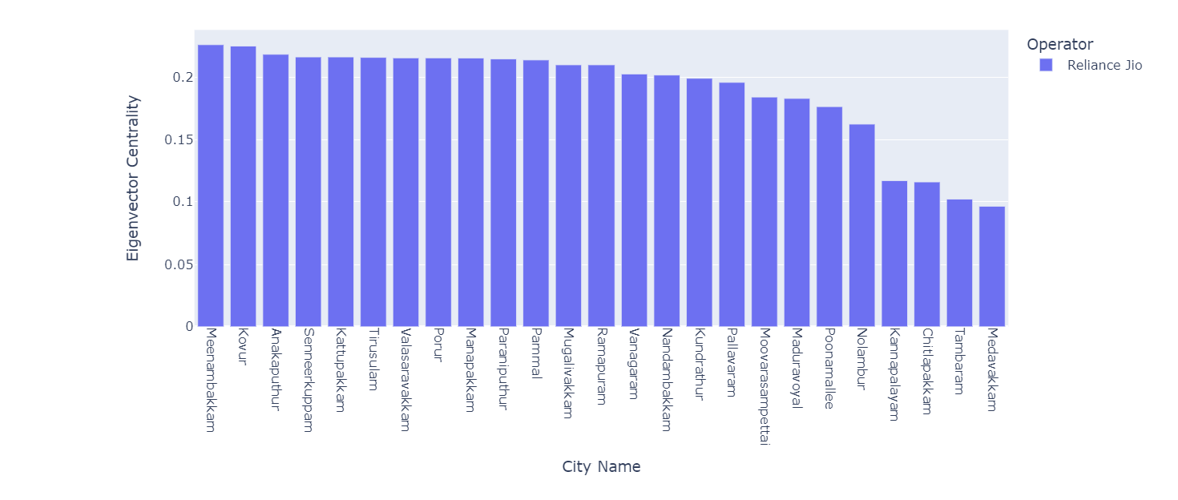
Top 25 Cities by Eigen-vector Centrality

Slide 17
Machine Learning Models
K-Nearest Neighbours
K-Means Clustering
Gaussian Mixture Model

Slide 18
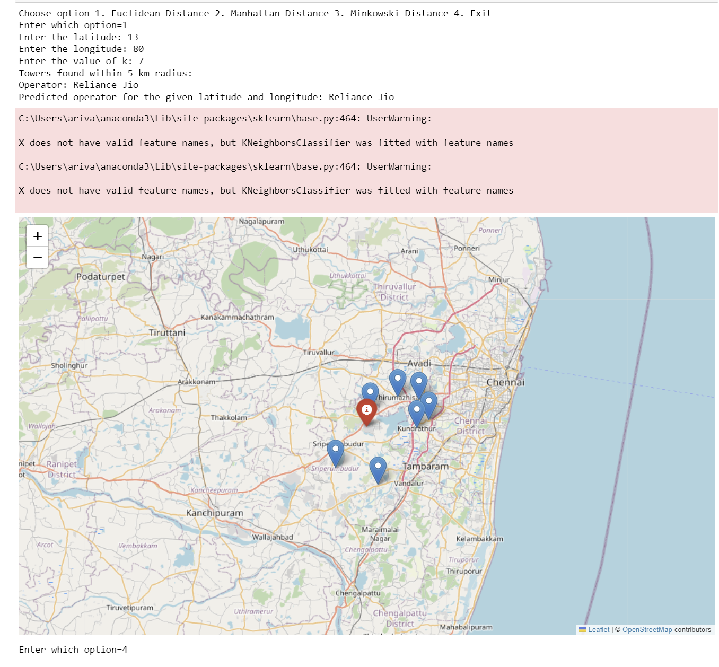
K-Nearest Neighbours
Using the user's location, we can identify the best 5G service provider for them by applying a K-nearest neighbor machine learning model. We will initially set the minimum range to 5 km, as this is the maximum distance at which 5G technology can effectively operate. We will then find the K nearest 5G operators based on the user's location and recommend the best one to the user.
Thus, for the given location Reliance Jio is the best operator to use 5G.

Slide 19
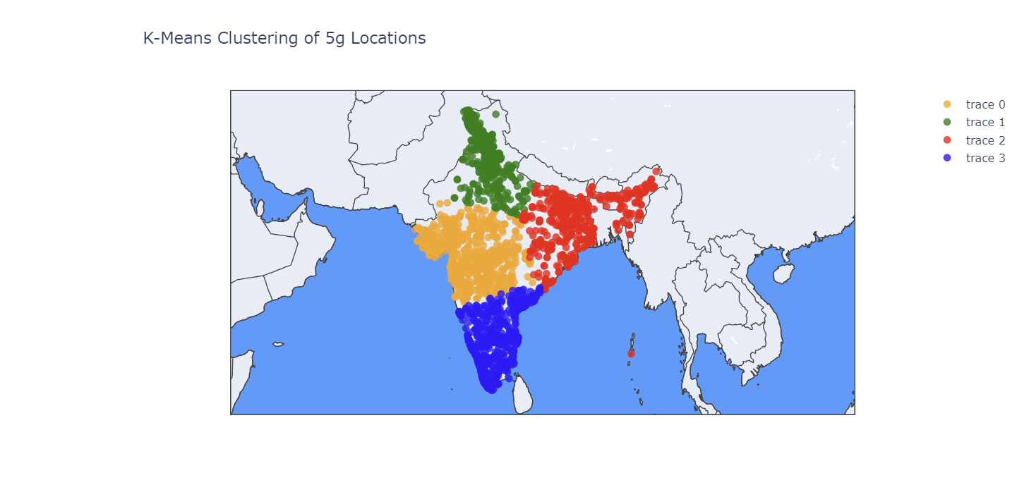
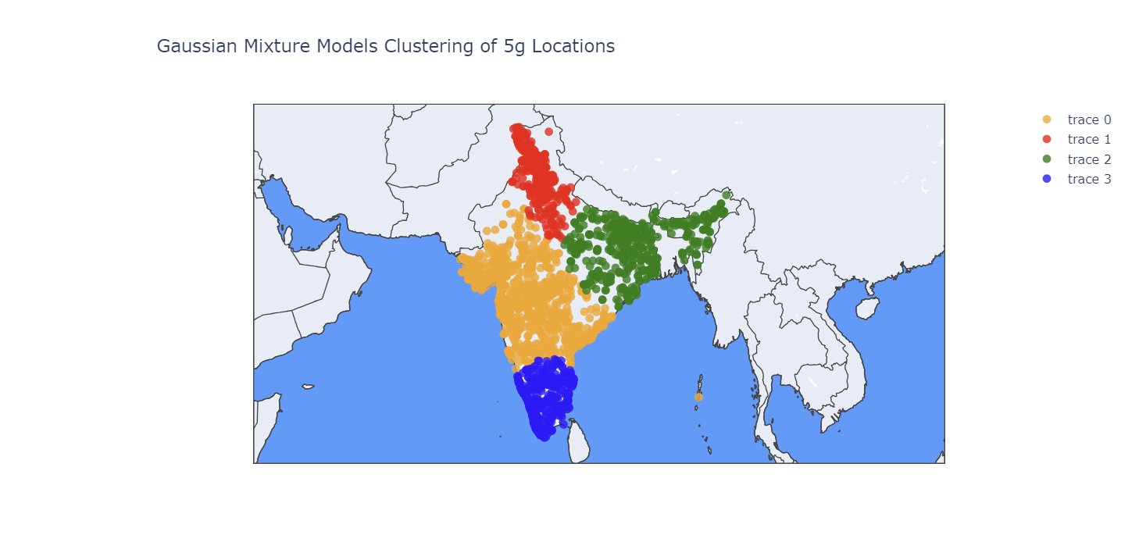
Comparison of Unsupervised ML models
K-Means Clustering
Gaussian Mixture Model
By comparing the two models, we can observe that the central region occupies a larger area in the Gaussian model compared to the K-means clustering model. This is potentially due to the higher degree of data point overlap in the southern and central regions of India, leading to a more expansive central region in the Gaussian model.

Slide 20
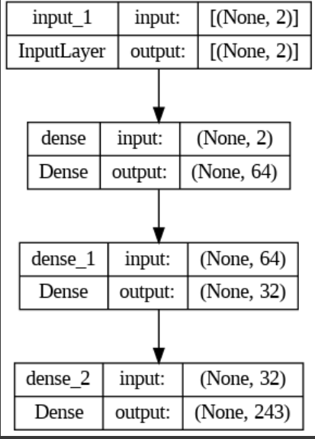
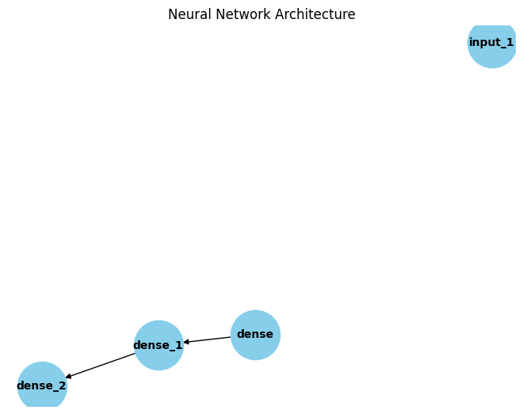
Graph Convolutional Neural Network
We used a Graph Convolutional Network (GCN) to predict the telecom operator (Airtel or Reliance Jio) based on location coordinates in our dataset. GCNs are well-suited for graph-structured data, where nodes are entities (like geographic points) and edges show relationships. The GCN can learn to associate operators with locations by leveraging spatial connections between nearby points. The latitude and longitude are input features, and the operator is the target. The GCN model will learn spatial patterns to accurately predict operators for new locations.

Slide 21
Conclusion
With the help of these ML models and centralities we were able to predict the desired network provider for each user. We were able to discuss about the clustering of the data points. Also, we were able to find out the centralities and their properties for certain networks.

